Slide 1


Search
Project Component 2
Presentation
Aryaman Pathak IMT2022513
Rishit Mane IMT2022564
Shreyas Biradar IMT2022529
Tanay Nagarkar IMT2022083

Slide 2


Dataset Selection
Our first task was to research and select a primary dataset for our Project Component 2. We focused on publicly available X-ray datasets.
Some Common datasets for Xrays we found:
NIH ChestX-ray14: A very large dataset from the NIH with 14 common thoracic pathologies.
CheXpert: A large-scale chest X-ray dataset from Stanford, notable for its focus on handling label uncertainty.
MIMIC-CXR: A comprehensive dataset linking chest X-rays with their associated free-text radiology reports.
PadChest: A large, high-resolution dataset with over 160,000 images and 174 different findings.
Our Selected Dataset - NIH ChestX-ray14 dataset

Slide 3
NIH ChestX-ray14
Source: The dataset was released by National Institutes of Health (NIH), It’s publicly available and can be found in Kaggle as well:
https://www.kaggle.com/datasets/nih-chest-xrays/data/
Size: It is a massive dataset containing 112,120 chest X-ray images from 30,805 unique patients.
Modality & View: The images are frontal-view Chest X-rays (CXR), which includes Posteroanterior (PA) and Anteroposterior (AP) views. The image resolution is 1024x1024 pixels.
Demographics: The dataset also includes a metadata file that contains patient-level information, including Patient ID, Patient Age, and Patient Gender, which we can use for demographic-based analysis.

Slide 4
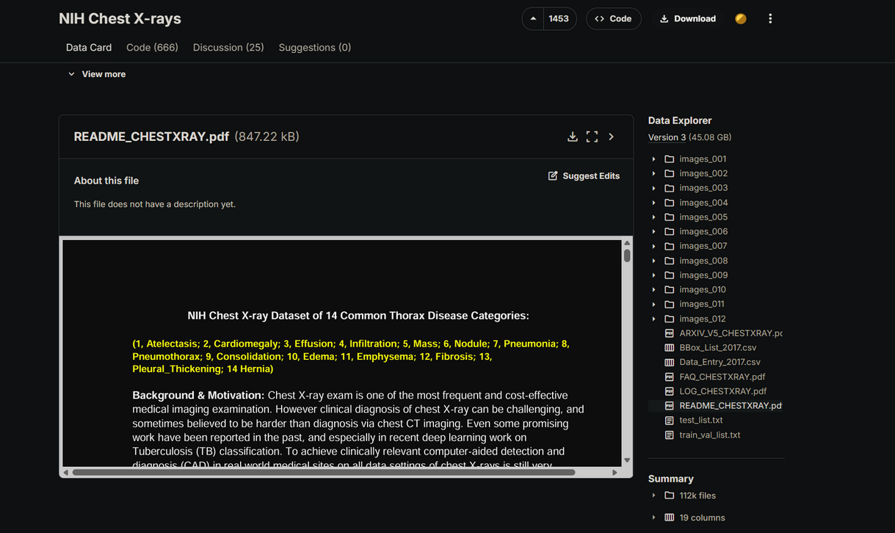
NIH ChestX-ray14
Labels: The dataset provides image-level labels for
14 common thoracic pathologies::
Atelectasis
Cardiomegaly
Consolidation
Edema
Effusion
Emphysema
Fibrosis
Hernia
Infiltration
Mass
Nodule
Pleural Thickening
Pneumonia
Pneumothorax
An additional label, "No Finding," is provided for images where none of the 14 pathologies are present. We chose this dataset because its picture quality is high resolution and it can be downloaded in parts it’s very small in size compare to other current datasets whose size e.g. of Chexpert is very huge 471 GBs.

Slide 5
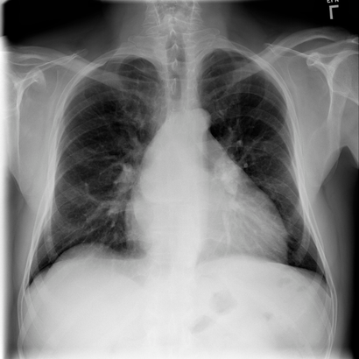
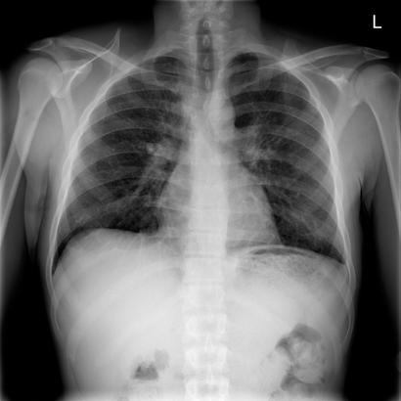
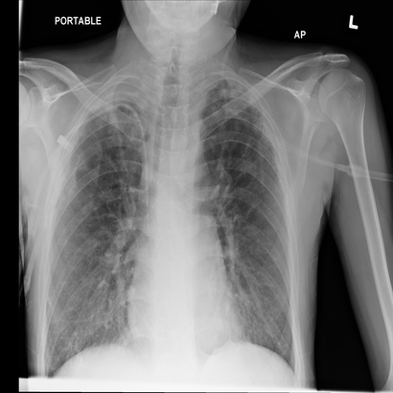
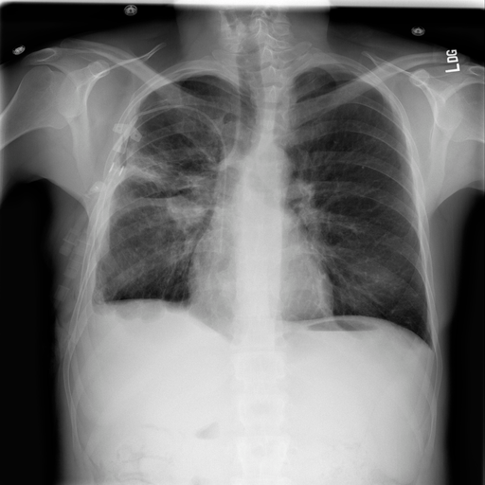
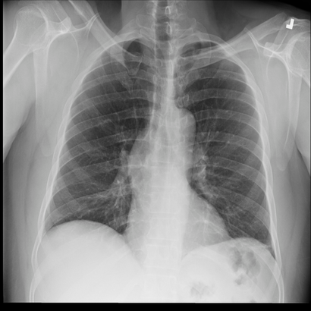
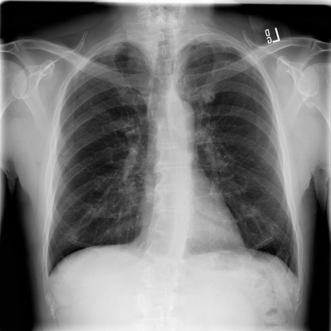
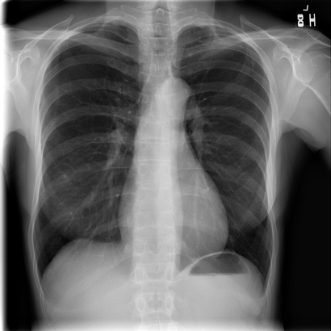
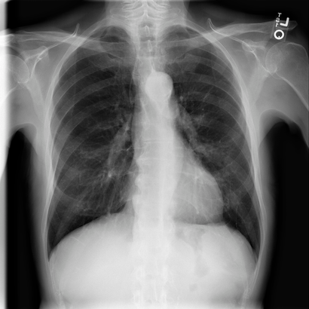
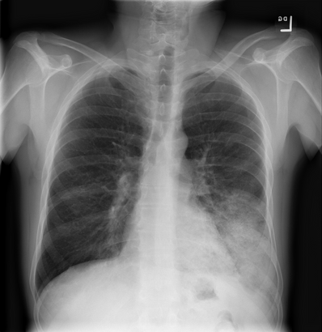
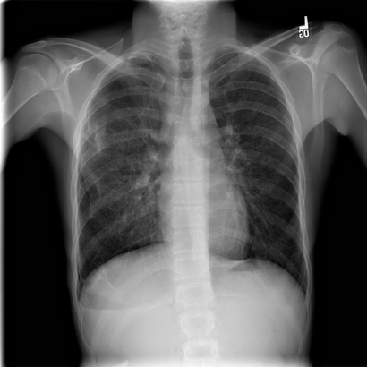
NIH ChestX-ray14
Sample Images used were:
Atelectasis
Cardiomegaly
Consolidation
Edema
Effusion
Emphysema
Fibrosis
No Finding
Pneumonia
Pneumothorax

Slide 6
Workflow Pipeline
1. IMAGE ACQUISITION & STANDARDIZATION
↓
2. IMAGE ENHANCEMENT
↓
3. NOISE HANDLING & RESTORATION
↓
4. HAND-CRAFTED FEATURE EXTRACTION
↓
5. ANALYSIS & VISUALIZATION
↓
6. PERFORMANCE EVALUATION & RANKING

Slide 7
1. IMAGE ACQUISITION AND STANDARDIZATION
We selected 10 Medical conditions from the dataset from each condition we chose 1 image
The conditions selected are : Atelectasis, Cardiomegaly, Consolidation, Edema, Effusion,Emphysema, Fibrosis, Pneumonia, Pneumothorax and No Finding. The details of the conditions are as follows:
Atelectasis – Partial or complete collapse of lung tissue, leading to reduced gas exchange.
Cardiomegaly – Abnormal enlargement of the heart, often due to hypertension or heart disease.
Consolidation – Solidification of lung tissue caused by fluid or infection filling the alveoli.
Edema – Accumulation of excess fluid in tissues; in lungs, it impairs oxygen exchange.
Effusion – Build-up of fluid in the pleural space surrounding the lungs.
Emphysema – Chronic lung disease causing destruction of alveoli, leading to breathing difficulty.
Fibrosis – Thickening and scarring of lung tissue, reducing elasticity and respiratory function.
Pneumonia – Infection causing inflammation and fluid accumulation in the lungs.
Pneumothorax – Presence of air in the pleural cavity causing lung collapse.
Standardization Process:
Image Loading: Automatic format detection and handling
Color Conversion: All images converted to grayscale
Size Normalization: Fixed 256×256 pixel dimensions
Directory Structure: Organized output for each condition

Slide 8
2. IMAGE ENHANCEMENT
Image Enhancement Techniques used:
Low-pass Filtering: 5×5 averaging for noise reduction
High-pass Filtering: Sharpening kernel for edge enhancement
Gaussian Smoothing: 7×7 kernel for gentle denoising
Histogram Equalization: Global contrast enhancement
CLAHE: Adaptive contrast with 8×8 tile grid
Sobel Edge Enhancement: Gradient magnitude fusion
Prewitt Edge Enhancement: Alternative edge detection
Frequency Domain Sharpening: High-frequency emphasis
Laplacian Filtering: Second-order edge enhancement
Best technique out of these depends on what the user’s requirements are:
If they want edge-refined images, they can go with Sobel or Prewitt. If they want contrast enhancement, they should use Histogram Equalization (H.E) or CLAHE.
If the aim is noise reduction or smoothing, Low-pass filtering and Gaussian smoothing are effective choices since they suppress random noise and minor intensity fluctuations.
For highlighting fine details or sharpening, High-pass filtering and Frequency Domain Sharpening are preferred as they boost high-frequency components, enhancing edges and textures.
Laplacian filtering is best suited when the goal is precise edge localization, as it captures rapid intensity changes using second-order derivatives.

Slide 9
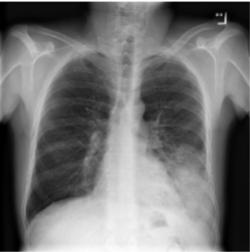
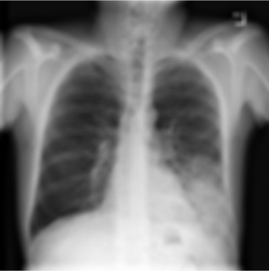
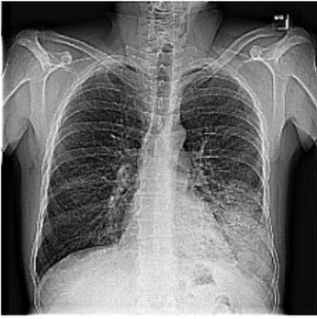
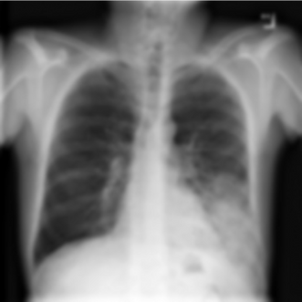
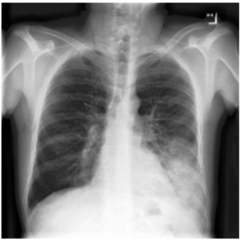
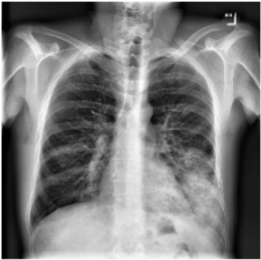
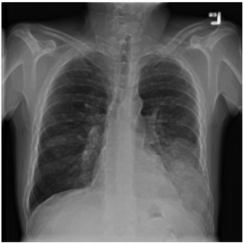
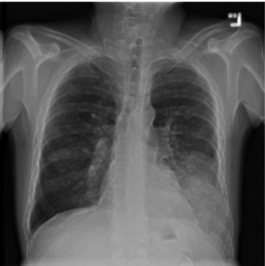


2. IMAGE ENHANCEMENT
Given below are examples for Pnemonia disease’s correspondoing images:
Original image
Low pass filtered image
High pass filtered image
Smoothed image
Histogram Equalized image
CLHAE image
Sobel Edge enhanced image
Prewitt Edge enhanced image
F.D. Sharpened image
Spatial filtered(Laplacian) image

Slide 10
3. Noise Handling and Restoration
The original images present in the datasert didn’t had any such noise visible in them so we simluated our own custom noise which are:
Gaussian Noise: Variance 0.002 - sensor noise simulation
Salt & Pepper Noise: 5% density - transmission errors
Mixed Noise: Combined Salt and pepper plus gaussian noise
Periodic Noise: Structured interference patterns
Band Patten noise
Motion Blur: Linear PSF for degradation simulation

Slide 11


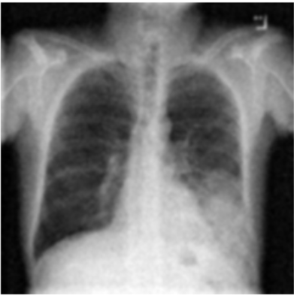

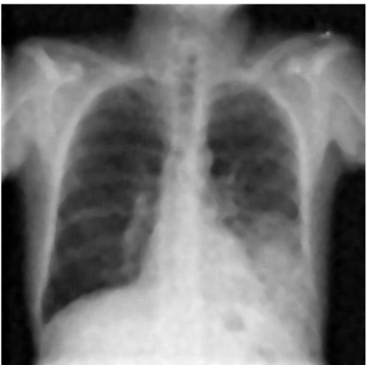

3. Noise Handling and Restoration
The original images present in the datasert didn’t had any such noise visible in them so we simluated our own custom noise and applied various Noise removal techniques to remove them. Pneumonia Images :
Original Image
Gaussian Noised Image
Gaussian Filtered Image
Mean Filtered Image
Median Filtered Image
Gemetric Mean filtered Image

Slide 12
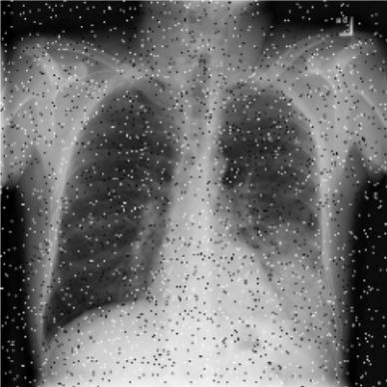



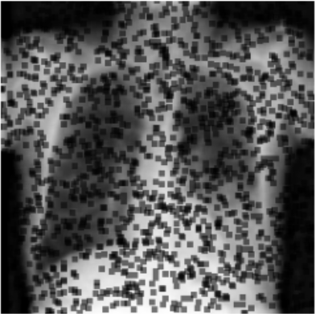
3. Noise Handling and Restoration
Pneumonia Images:
Original Image
Salt and Pepper Noised Image
Gaussian Filtered Image
Mean Filtered Image
Median Filtered Image
Gemetric Mean filtered Image

Slide 13
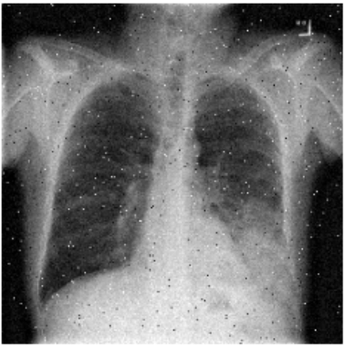

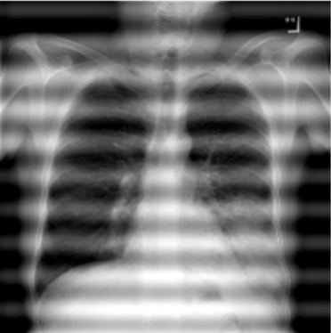
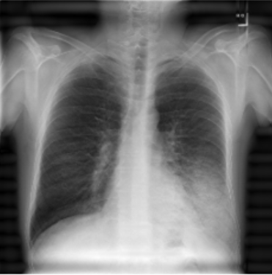
3. Noise Handling and Restoration
Pneumonia Images:
Original Image
Image which has a mixture of
S&P plus Gaussian
Aplha -Trimmed Mean Filtered Image
Original Image
Band Noised Image
Band Pass Filtered Image

Slide 14





3. Noise Handling and Restoration
Pneumonia Images:
Original Image
Pattern/Sinusoidal based Noise
Notch Filtered Image
Original Image
Motion Blurred Image
Weiner Filtered Image
Custom Weiner Filtered Image

Slide 15
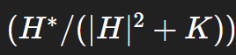
3. Noise Handling and Restoration
OBSERVATIONS
We can observe after looking at the images that for Gaussian noise gaussian filter worked best
For Salt and pepper noise median filter worked best
For mixture of gaussian and S&P Alpha Trimmed Mean filter effectively removes the noise
For Patterned/Sinusoidal Noise Notch filter effectively removes the noise
For Motion Blurred Noise Weiner filter works good but the custom filter which we made performed better than original weiner filter. The custom_wiener function which we used: performs image deconvolution using the Wiener filtering principle in the frequency domain. It begins by padding the point spread function (PSF) to match the image size and centering it using np.roll. The input image and padded PSF are then transformed to the frequency domain using the Fast Fourier Transform (FFT). The conjugate of the PSF’s spectrum is computed, and a Wiener filter is formed using the formula , where K is a small constant that prevents division by zero and controls noise suppression. The filtered spectrum is multiplied with the degraded image spectrum to estimate the restored image in the frequency domain, and the result is transformed back using the inverse FFT. Finally, the magnitude is taken and values are clipped between 0 and 1, producing a deblurred and denoised image.

Slide 16
4. Hand Crafted Features Extraction
Basic Statistical Features:
We extracted Intensity Distribution features such as mean, standard deviation, and variance to describe the overall brightness and contrast variations within the image.
We calculated Shape Characteristics like skewness and kurtosis to analyze the asymmetry and peakedness of the intensity distribution.
We computed Shannon Entropy to measure the information content or randomness present in the image.
2. Texture Analysis (GLCM):
We performed Gray-Level Co-occurrence Matrix (GLCM) analysis to capture spatial relationships between pixel intensities.
Contrast was used to measure local intensity variations.
Dissimilarity quantified the difference between neighboring pixel values.
Homogeneity evaluated the uniformity or smoothness of the texture.
Energy represented the texture uniformity or repetition of intensity patterns.
Correlation measured the linear dependency between neighboring pixel intensities.
3.Local Binary Patterns (LBP):
We applied Uniform LBP using an 8-point neighborhood with radius 1 to encode local texture patterns.
We computed Histogram Features with a 9-bin distribution to capture the frequency of different local patterns.
4.Shape Descriptors:
We extracted Hu Moments, which are seven rotation-invariant shape moments, to describe the geometric and spatial characteristics of image regions.
All features were extracted and saved in a csv file which was later used for evaluations.

Slide 17
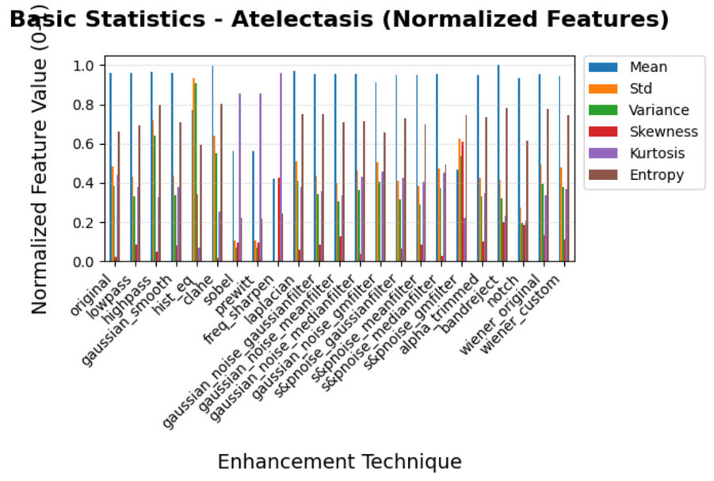
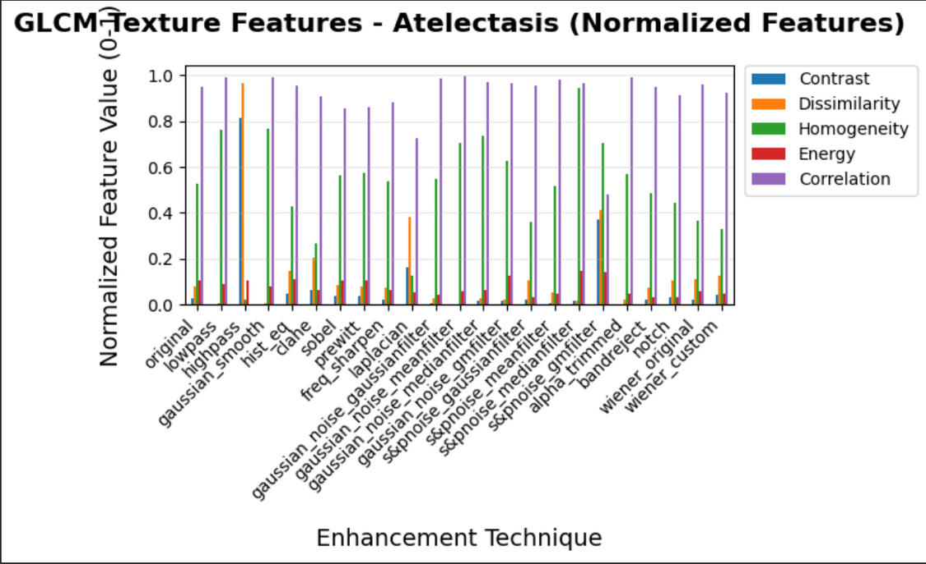
4. Hand Crafted Features Extraction
Hand crafted csv had:
Shape: (230, 30)
Original Images: ['Atelectasis' 'Cardiomegaly' 'Consolidation' 'Edema' 'Effusion' 'Emphysema' 'Fibrosis' 'No Finding' 'Pneumonia' 'Pneumothorax']
Techniques: ['original' 'lowpass' 'highpass' 'gaussian_smooth' 'hist_eq' 'clahe' 'sobel' 'prewitt' 'freq_sharpen' 'laplacian' 'gaussian_noise_gaussianfilter' 'gaussian_noise_meanfilter' 'gaussian_noise_medianfilter' 'gaussian_noise_gmfilter' 's&pnoise_gaussianfilter' 's&pnoise_meanfilter' 's&pnoise_medianfilter' 's&pnoise_gmfilter' 'alpha_trimmed' 'bandreject' 'notch' 'wiener_original' 'wiener_custom']
Below we are showing the stats for 1 class Atelectasis, in code we similarly have created for the rest 9 other classes aswell.

Slide 18
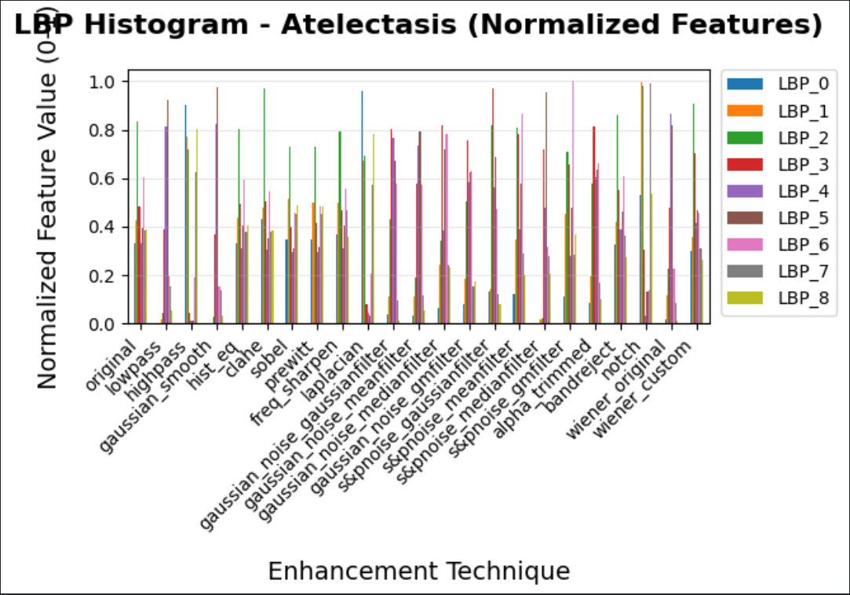
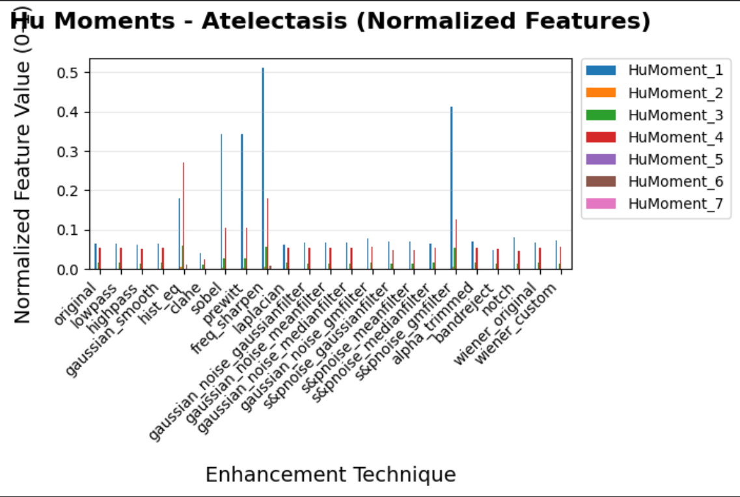
5. ANALYSIS & VISUALIZATION
Below we are showing the stats for 1 class Atelectasis, in code we similarly have created for the rest 9 other classes aswell.
LBP0, LBP1, LBP2, … are the individual feature components of the Local Binary Pattern histogram that encode different LOCAL TEXTURE patterns in the image
HuMoment_1, HuMoment_2, … are the seven invariant SHAPE features that uniquely describe an object’s geometry, remaining unchanged under rotation, scaling, or translation.Each Hu Moment captures a specific geometric property of the image — such as symmetry, elongation, or spatial distributioN.
In the Average stats can also be found which are across all the classes images
code

Slide 19
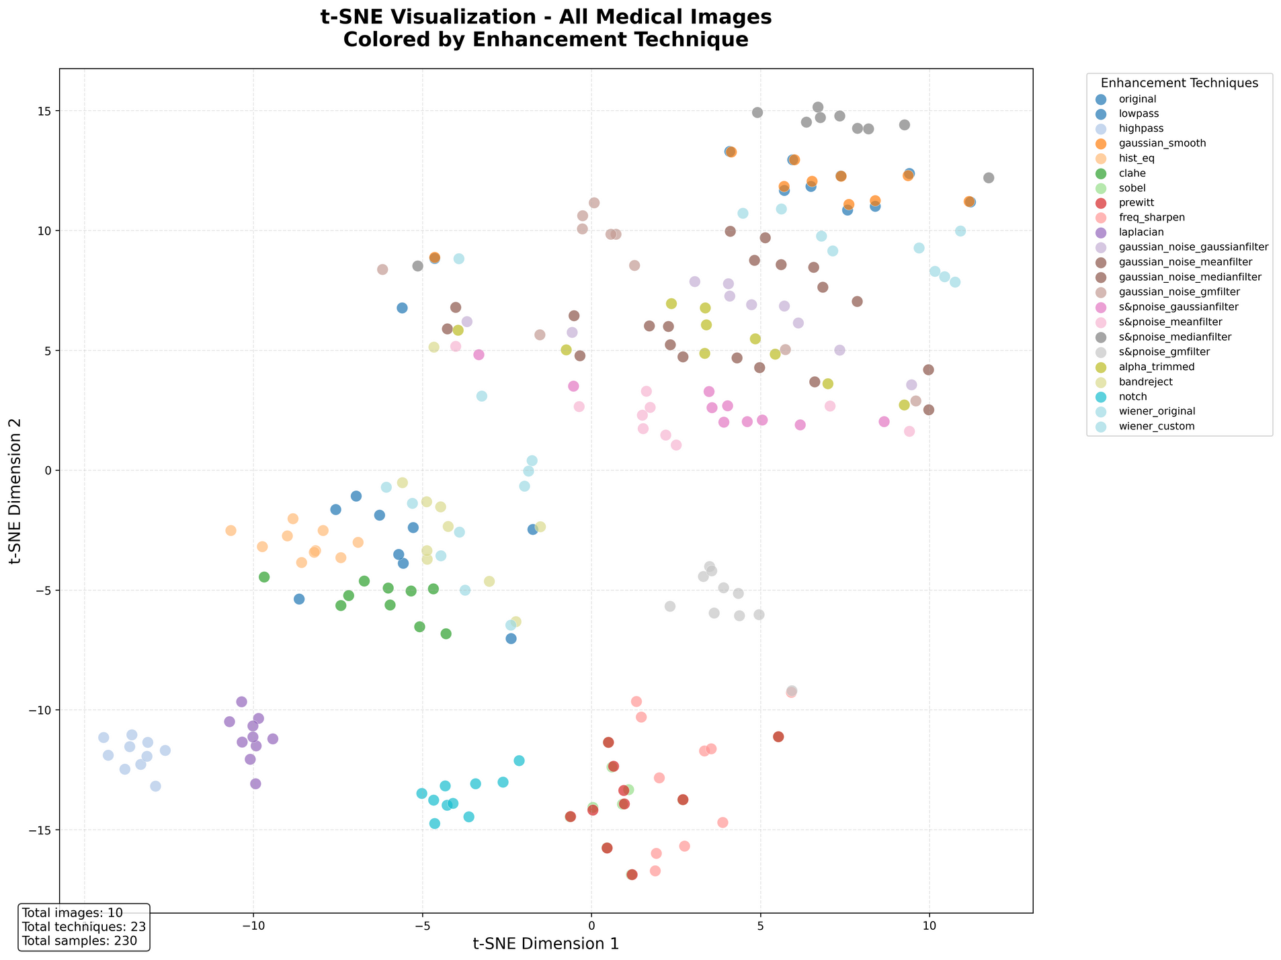
5. ANALYSIS & VISUALIZATION
Combined t-SNE visualization across
all techniques:
A t-SNE (t-distributed Stochastic Neighbor Embedding) plot is a nonlinear dimensionality reduction technique that visualizes high-dimensional data in two or three dimensions while preserving local similarities. The given t-SNE visualization represents the distribution of all medical images enhanced using 23 different techniques, each indicated by distinct colors. The clear clustering of points indicates that the features extracted from images processed with similar enhancement techniques exhibit comparable characteristics, leading to well-separated groups in the 2D space. For example, some techniques such as lowpass, gaussian_smooth, and wiener_custom form compact clusters, suggesting they produce feature sets distinct from others, while overlapping clusters between certain methods (e.g., gaussian_noise variants) imply partial similarity in their enhancement effects. The bottom-left box notes that the visualization is based on 10 original images enhanced using 23 techniques, resulting in 230 total samples, confirming good diversity and meaningful differentiation across enhancement methods.

Slide 20
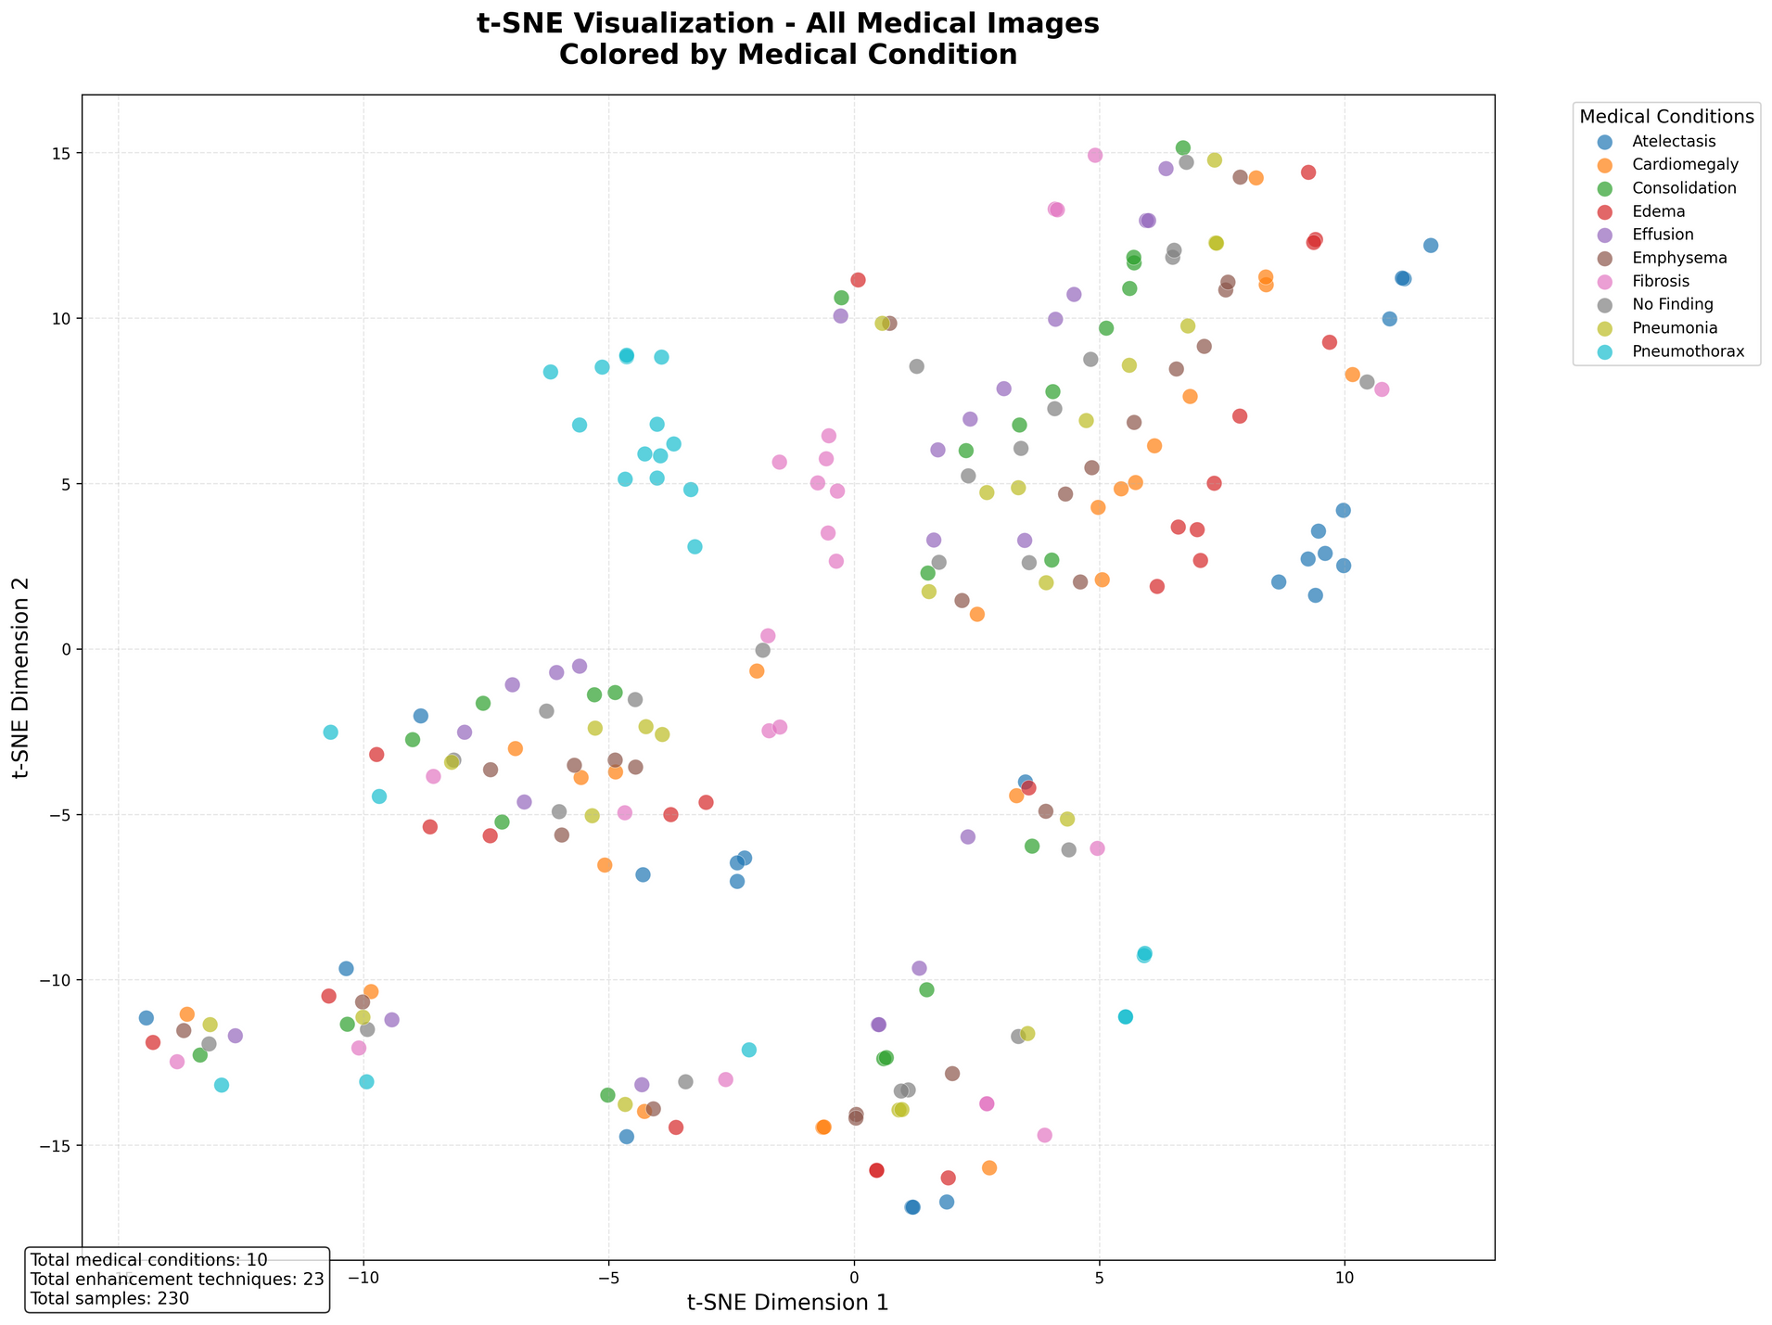
5. ANALYSIS & VISUALIZATION
Combined t-SNE visualization across
all classes:
The t-SNE visualization shown represents all medical images distributed based on their extracted feature similarities and colored according to ten distinct medical conditions. The plot reveals that samples belonging to certain conditions, such as Atelectasis, Pneumonia, and Cardiomegaly, tend to form moderately distinct clusters, indicating that these conditions possess unique visual characteristics captured by the extracted features. However, partial overlaps between conditions like Edema, Effusion, and Fibrosis suggest some shared visual traits, possibly due to similar pathological patterns in medical images. Overall, the scattered yet structured distribution indicates that while the features effectively differentiate certain conditions, others exhibit inter-class similarity, reflecting the inherent complexity of distinguishing subtle medical abnormalities. The summary box notes that the visualization is based on 10 medical conditions, 23 enhancement techniques, and 230 total samples, confirming a diverse and well-balanced dataset.
In code we have individual class-wise aswell

Slide 21
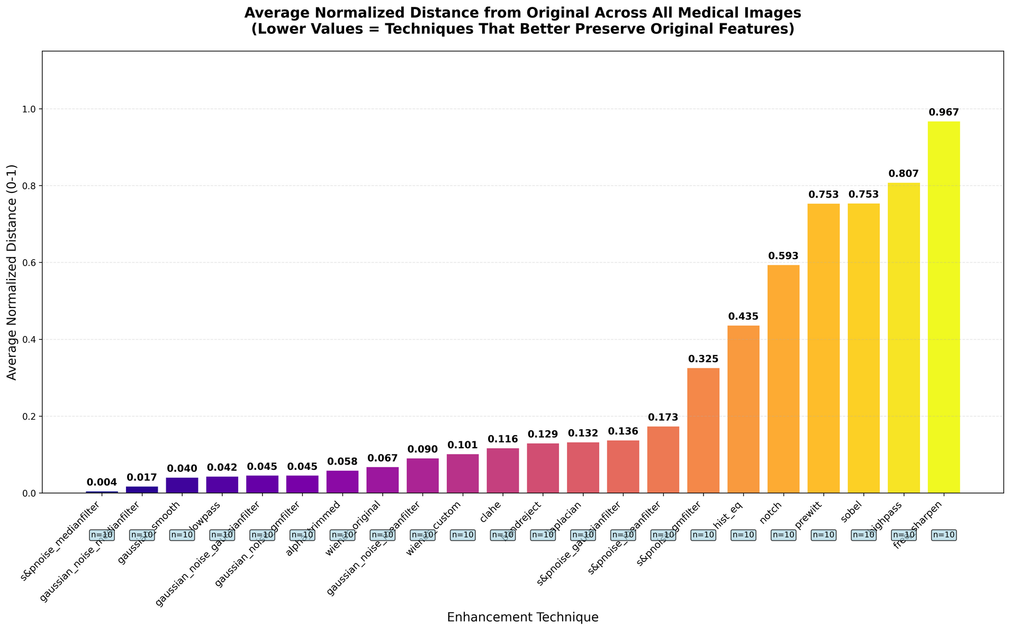
5. ANALYSIS & VISUALIZATION
Eculidiean distance based

Slide 22
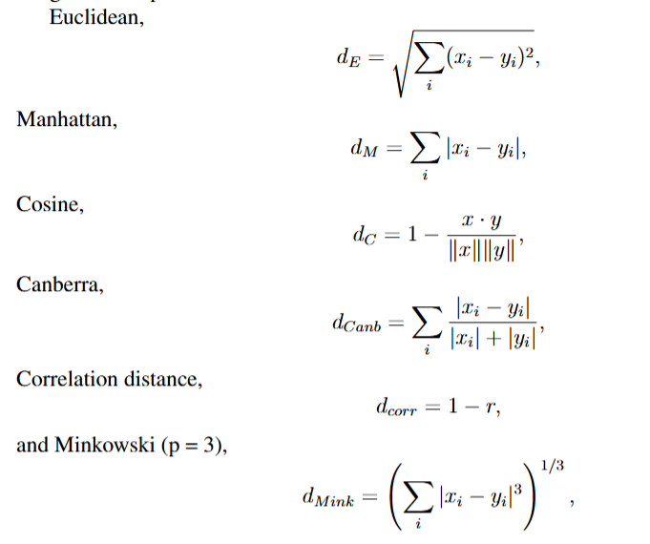
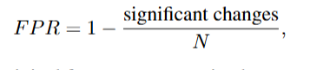
6. PERFORMANCE EVALUATION & RANKING
We used a multi-metric weighted scoring system to evaluate and rank medical image enhancement techniques by comparing handcrafted features of original and processed images.
We computed distance metrics where lower values indicated higher similarity.
We also computed similarity metrics — Pearson correlation (linear), Spearman correlation(rank-based), Mutual Information, I(X;Y),capturing non-linear dependency, and the Feature Preservation Ratio,measuring how much of the original features were retained.
After normalization, each metric was assigned a weight reflecting its importance: Euclidean (0.15), Manhattan (0.10), Cosine (0.15), Pearson (0.15), Spearman (0.10), MutualInformation (0.15), and Preservation Ratio (0.20). These weighted scores were then combined into an overall score for each enhancement technique per medical condition, allowing the system to rank enhancement methods objectively by balancing distance, similarity, and information-preserving characteristics.

Slide 23
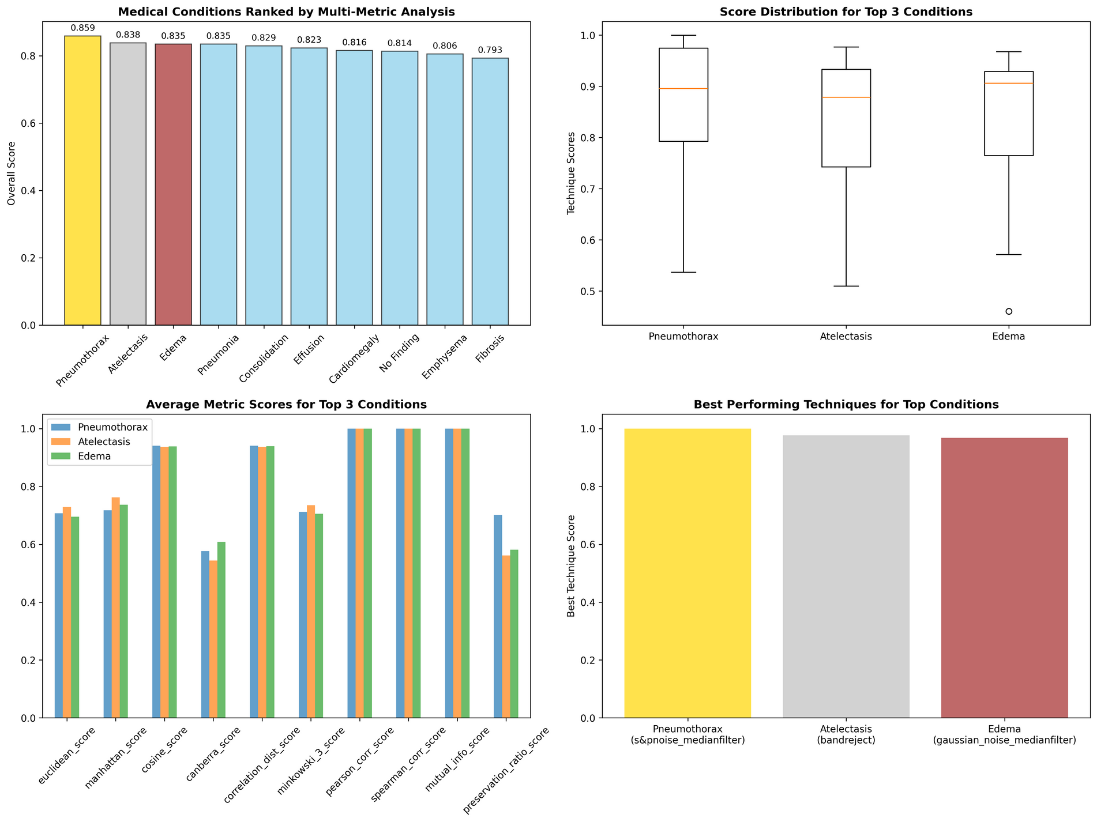
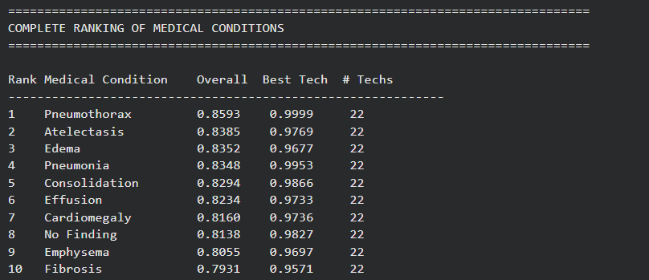
6. PERFORMANCE EVALUATION & RANKING

Slide 24
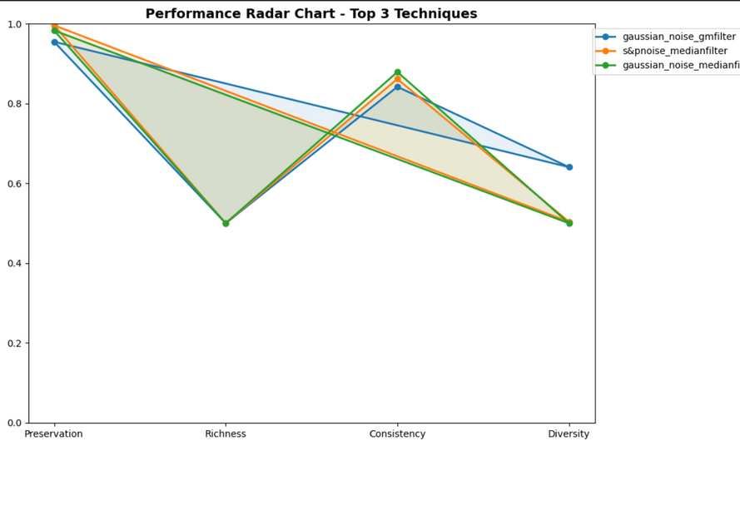
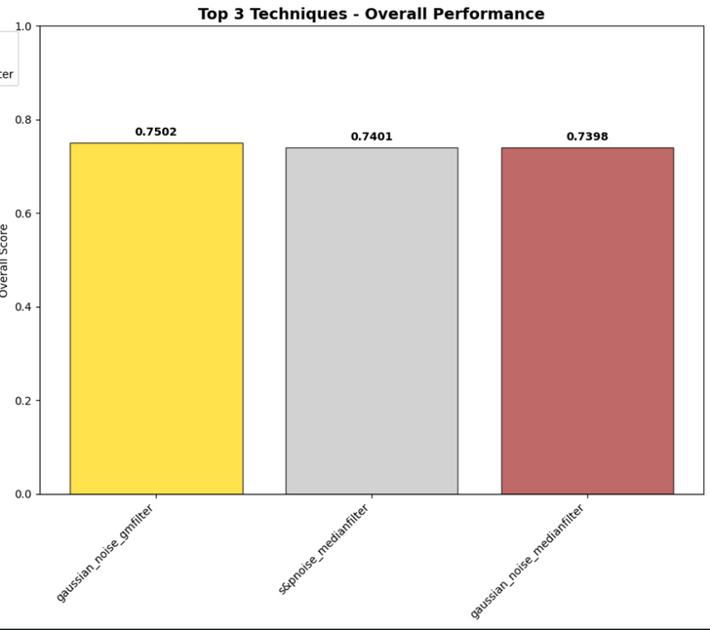
6. PERFORMANCE EVALUATION & RANKING
We ranked different image enhancement techniques based on their handcrafted feature performance across multiple metrics. First, we calculated Feature Preservation by measuring how closely each enhanced image retained the original’s features using normalized Euclidean distances. Next, we measured Feature Richness by checking how many feature values (like entropy, contrast, energy, and homogeneity) fell within desirable ranges that indicated visually and statistically rich images. We then assessed Consistency by calculating the coefficient of variation of key features across multiple images, rewarding techniques with stable performance. Feature Diversity was analyzed by checking the proportion of features that changed significantly from the original, ensuring meaningful enhancement rather than mere duplication. Each metric was weighted (Preservation 30%, Richness 25%, Consistency 25%, Diversity 20%) to compute a final Overall Score for every technique. The script displayed the Top 3 best-performing techniques both numerically and visually using radar and bar charts, and summarized each method’s strengths (like preservation, richness, or consistency) for clear recommendation.

Slide 25
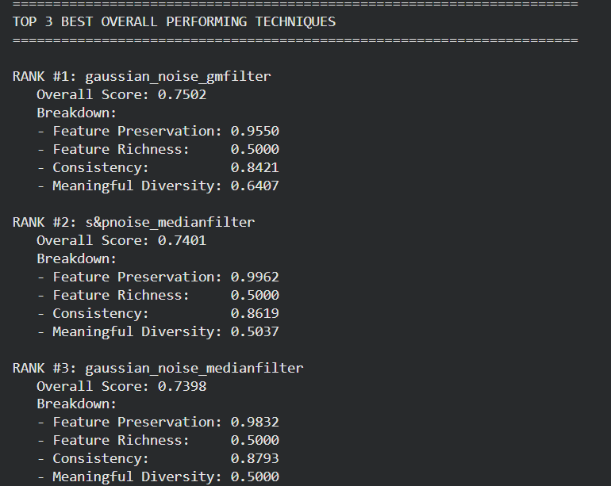
6. PERFORMANCE EVALUATION & RANKING

Slide 26
All Codes, results , sampled images and dataset can be found here:
REFERENCES:
Gonzalez, R. C., & Woods, R. E. (2018). Digital Image Processing (4th ed.). Pearson.
Haralick, R. M., Shanmugam, K., & Dinstein, I. (1973). “Textural features for image classification.” IEEE Transactions on Systems, Man, and Cybernetics, 3(6), 610–621.
Wang, Z., Bovik, A. C., Sheikh, H. R., & Simoncelli, E. P. (2004). “Image quality assessment: From error visibility to structural similarity.” IEEE Transactions on Image Processing, 13(4), 600–612.
Ojala, T., Pietikäinen, M., & Harwood, D. (1996). “A comparative study of texture measures with classification based on featured distributions.” Pattern Recognition, 29(1), 51–59.
https://github.com/Tanay-iiitb/PC2
Get Started

